Slide 1

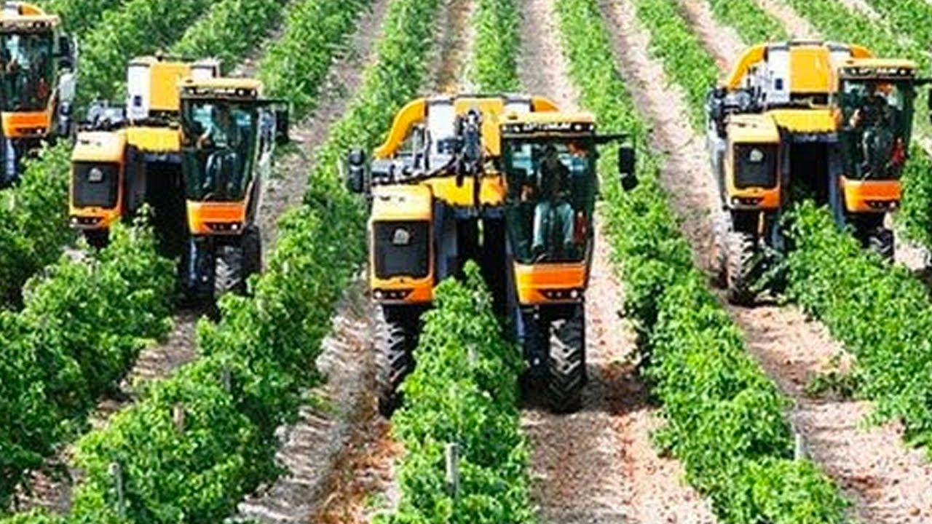
DEPARTMENT OF ELECTRONICS AND COMMUNICATION ENGINEERING MAJOR PROJECT: third REVIEW E-COMMERCE PLATFORM FOR FARMERS
PRESENTED BY:
ADITI DUBEY: 1KS20EC002
GANDHAMANI CM: 1KS20EC030
HARSHITHA J: 1KS20EC035
MEGHASHREE M: 1KS20EC057
GUIDED BY: MR SANTHOSH KUMAR B R

Slide 2
INTRODUCTION
Farmer to Consumer website platform.
Sensors like pH, Humidity, and water were used in order to improve precision.
Consumers will be able to access comprehensive product information.

Slide 3
LITERATURE SURVEY
Sl no | Paper titile | Author names | Conclusion | Advantages
1 | Development of Web Based System for Farmer to Consumer Product Selling Through Direct Marketing 2022 | Pritam Ramteke, Sandeep Pathak, Pooja Raut, Pradnya Sarade, Naina Palandurkar | In This web-based program will help farmers know more about market information. Farmers can get more profit than any other preexisting program because of the simplicity of the program. It will work as a separate look for plans and compensation | It is very helpful, reliable and performs well functional to get an alert message and emails on cell phone or by emails. Also, this system helps us to take the record of Farmers.
2 | A Web System for Farming Management 2020 | Glaubos Climaco, Fernando Chagas, Valéria M. Silva, Gentil V. Barbosa, and Patrick Letouze | The system plays a role as an interface between government and specialized technicians and farmers. In that way, technical support and guidance could be provided in a long distance form or reducing on site activities. | This work is part of a project that intends to support small farmers in poor regions of Brazil called “territórios da cidadania” (citizenship territories).
3 | A WEB-DESIGNED SMART FARMING SYSTEM: “APPLICATION FROM FARMERS TO CONSUMERS” 2023 | Dr. Dayanand G. Savakar*1, Mahesh Bijjaragi*2, Danesh Telsang*3 | The study clearly illustrated changes in consumer marketing practices and focused on online purchasing by farmers. The company has gained too much popularity due to the best services in providing high quality fruits and vegetables. | Online selling of vegetables is the right way for modern people. With this application, farmers get their profit without any intermediaries between their sales.

Slide 4
Sl no | Paper titile | Author names | Conclusion | Advantages
4 | Online farm management system 2023 | Aditya D. Giradkar Anisha A. Pakhmod Ankit S. Mehere Radha B. Naktode | The specific objectives of the project include: To provide qualitative foods to the buyers. Implementing an automated/online agro culture system.ϖ To inspire farmer to produce quality goods and supply to the buyers. | Less effort and less labour intensive, as the primary cost and focus primarily on creating, managing, and running a secure quality food supply. · Increasing the number of buyers as individuals will find it easier and more convenient to buy goods. · Easy management.
5 | Homegrowns: An E-Commerce platform for farmers. 2023 | Jithendra Varma,Achyuta Sai, Rajesh Reddy, Sai Divya, Baby Sri Divya, Madhukumar Patnala | Homegrowns, an e-commerce platform, we connected farmers with customers directly without the involvement of mediators and the agricultural marketing of the farmer's products was made in a more effective and eco-friendly way than that of mediators. | E-commerce also opens up new business opportunities for both customers and farmers and allows them to compare prices with the competitors.

Slide 5
PROBLEM IDENTIFICATION
Due to lack of monitoring many crops die out.
Many farmers are still relying on traditional farming techniques which will lead to reduce in production.
Existence of Middle men.
Younger generation are moving to urban areas.

Slide 6
CROP PARAMETERS
CROP | TEMPERATURE In degree (Celsius) | HUMIDITY | pH LEVEL | TYPE OF SOIL | DURATION
CAPSICUM | 18 – 27 | 55 – 65% | 6 – 6.5 | SANDY | 45 DAYS
PEAS | 21-27 | 60 – 80% | 6 | SANDY | 18 - 22 DAYS
TOMATO | 21 - 24 | 60 – 85% | 5 - 7 | SANDY | 50 DAYS
BEANS | 16 - 25 | 70 – 80% | 7 -7.5 | SANDY | 10 - 30 DAYS

Slide 7
OBJECTIVES
Direct communication between farmers and consumer in order to eliminate middle men.
Develop a website which includes farmer and consumer menu.
Using moisture, temperature, humidity, and pH sensors to monitor environmental conditions in real time.
Consumer can choose the required crop and quantity and place order via website.
Store the data on the database and predict yield production by using various data analytics tools like Power BI.
Depending on the quantity of the crops ordered by the customer the orders will be dispatched in different vehicles.

Slide 8
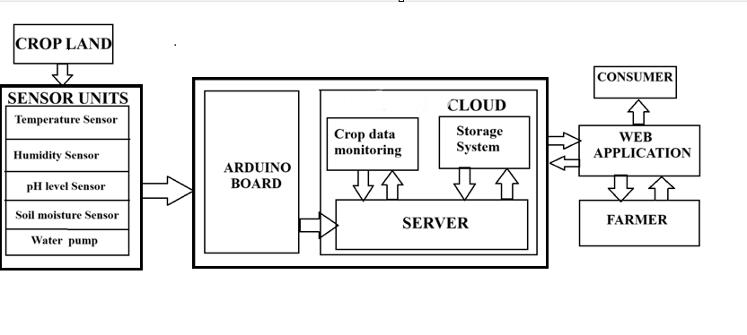
BLOCK DIAGRAM - HARDWARE

Slide 9
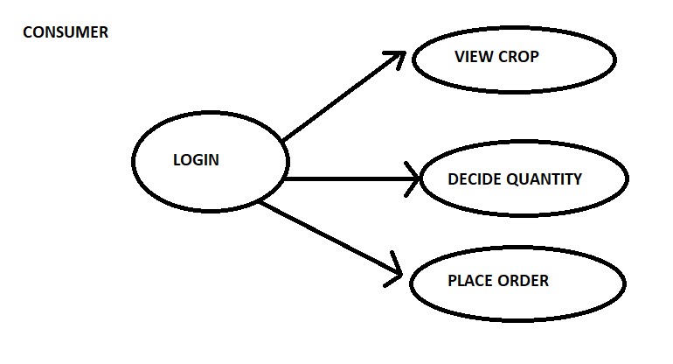
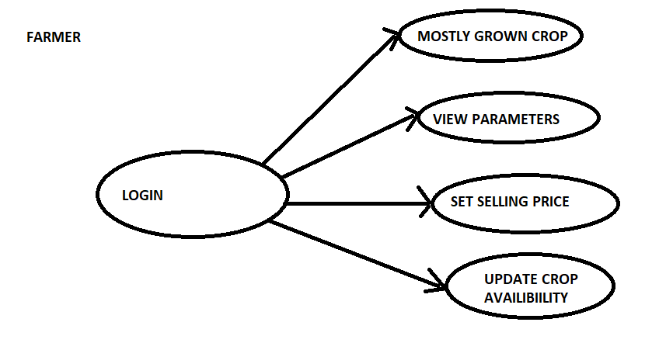
BLOCK DIAGRAM - SOFTWARE
CONSUMER FARMER

Slide 10
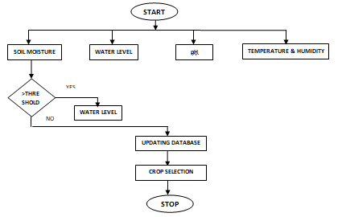
FLOW CHART- FARMER

Slide 11
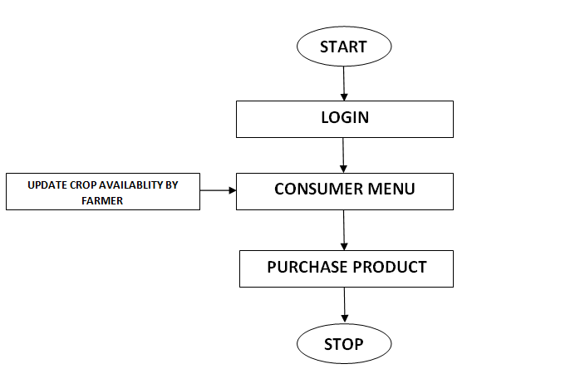
FLOW CHART-CONSUMER

Slide 12
HARDWARE COMPONENTS
ARDUINO
TEMPERATURE SENSOR
SOIL MOISTURE SENSOR
WATER LEVEL INDICATOR
WATER PUMP
HUMIDITY SENSOR
pH SENSOR

Slide 13
SOFTWARE TOOLS REQUIRED
POWER BI
SQL
ARDUINO IDE
GOOGLE CLOUD
HTML, CSS,JAVASCRIPT
PYTHON, JAVA

Slide 14
WORKING OF THE PROJECT
Data from different sensors are collected.
Develop a website.
On the Developed website provide a farmer and consumer menu.
Farmer can compare the parameters of the soil and start cultivation.
After cultivation farmer will update the data on to the website which will be visible for the consumer.
Consumer can buy the required crop.

Slide 15
APPLICATION:
Green house automation
Food production and automation
Precision Agriculture
Integrated Pest Management (IPM)
Automation of irrigation system
Water quality monitoring
Precision livestock farming

Slide 16
DEMONSTRATION PLAN
Four Different crops are grown.
Parameters are collected by sensors and displayed on the website.
Information on crop availability can be viewed on the website by the consumer.
After the crops are dispatched, farmers will update the availability of the crops daily.
The consumer can choose the crop and quantity based on his requirements.
Depending on the quantity of the crops ordered by the customer the orders will be dispatched in different vehicles.

Slide 17
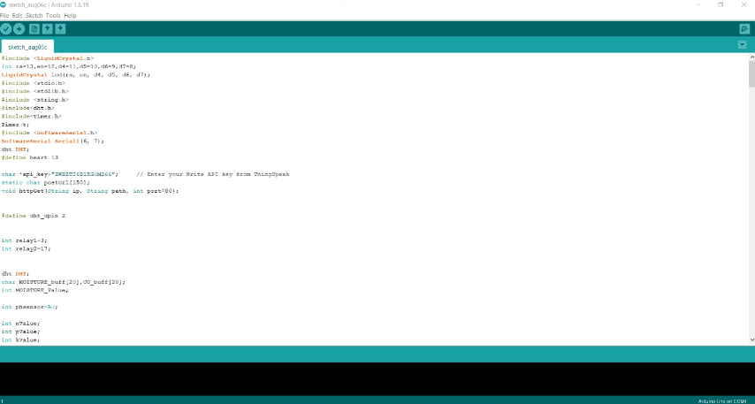
TOOLS LEARNED
Coding of the hardware components is implemented using arduino ide

Slide 18
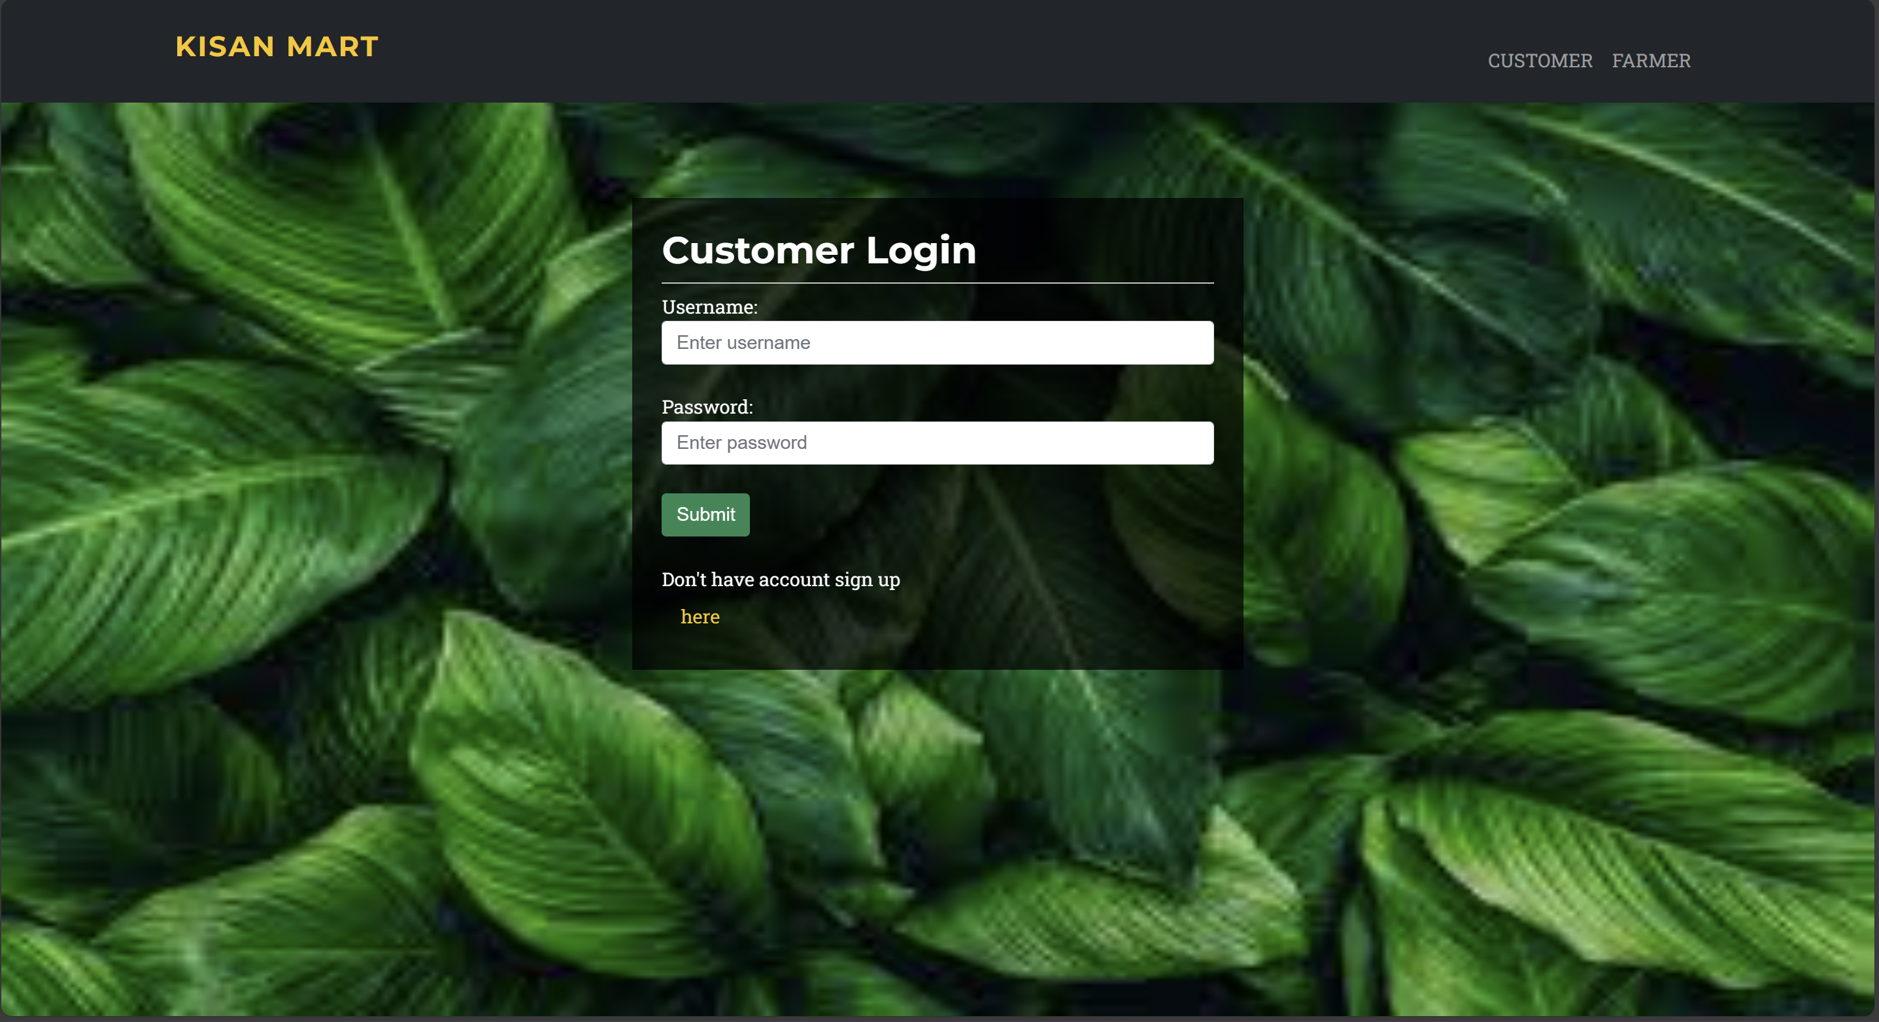
Frontend part of the website is developed using css and html and the codes
are written in Visual studio

Slide 19
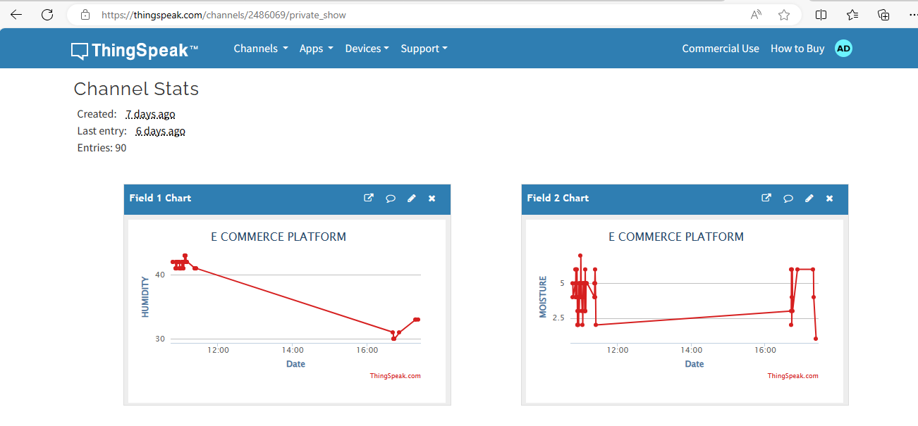
The data collected from the sensors is stored in the ThingSpeak platform

Slide 20
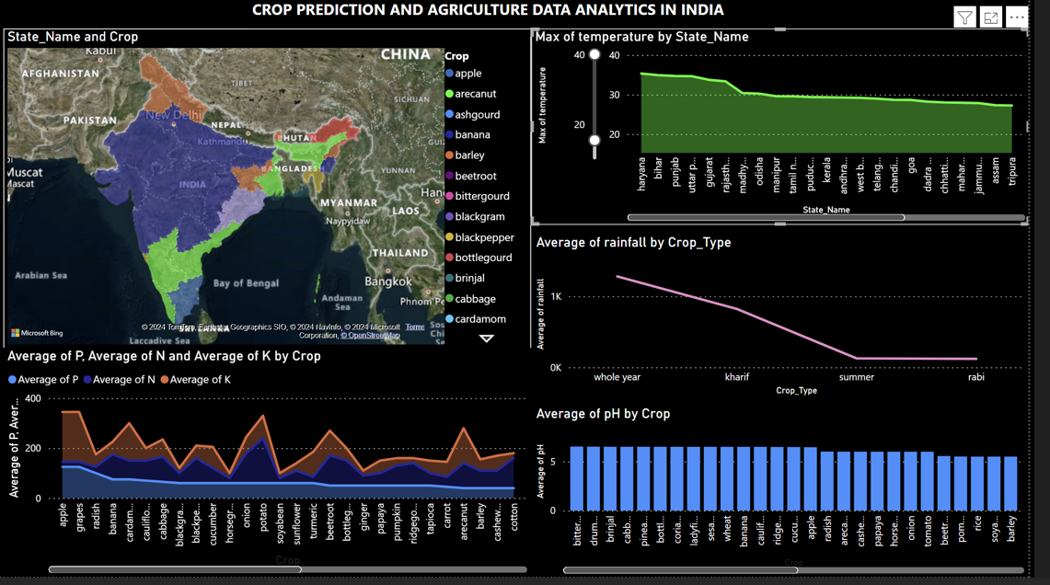
Data analysis of the collected data is performed in power bi tool

Slide 21
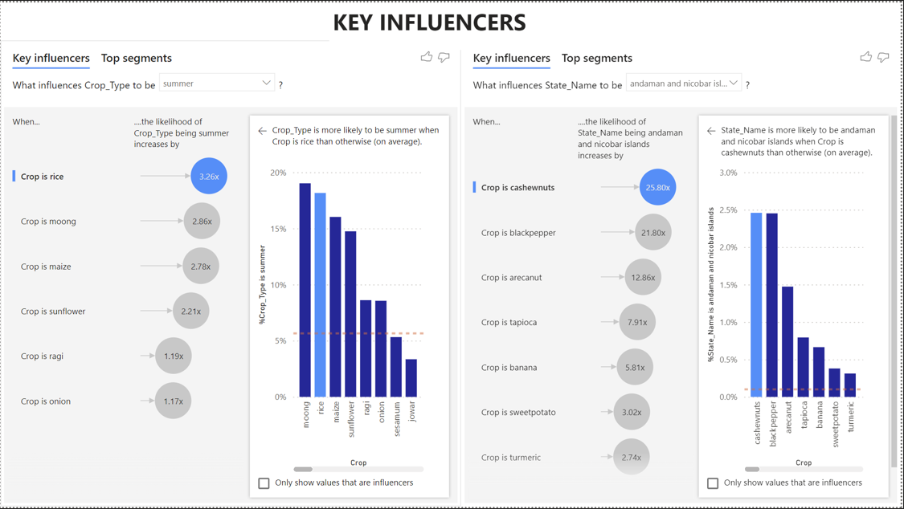

Slide 22
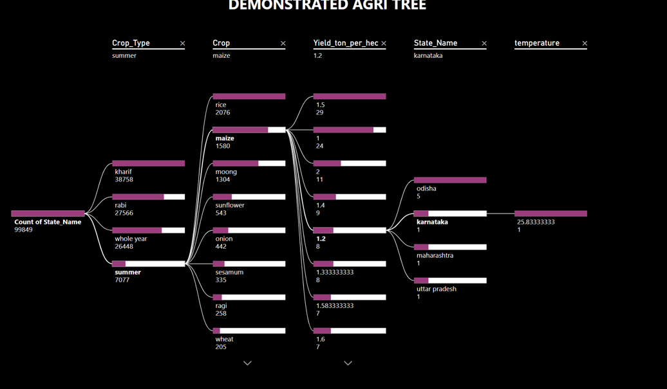

Slide 23
INDIVIDUAL CONTRIBUTION
TEAM MEMBER | CONTRIBUTION
ADITI DUBEY | DEVELOPED THE BACKEND PART OF THE WEBSITE USING PYTHON
GANDHAMANI CM | DEVELOPED DASHBOARDS WITH THE DATA COLLECTED USING POWERBI
HARSHITHA J | DEVELOPED THE FRONTEND PART OF THE WEBSITE USING CSS AND HTML
MEGHASHREE M | WRITTEN THE CODE FOR THE HARDWARE PART IN AURDINO IDE

Slide 24
PROJECT EXECUTION PLAN
WEEK | WORK DONE
WEEK1 | LITERATURE SURVEY
WEEK2 | PROBLEM IDENTIFICATION
WEEK3 | DESING OF ALGORITHM
WEEK4 | IMPLEMENTING THE EMBEDDED C ALGORITHM
WEEK5 | BUYING THE COMPONENTS
WEEK6 | TESTING THE COMPONENTS
WEEK7 | ASSEMBLING THE COMPONENTS
WEEK8 | SETTING UP IRRIGATION PIPES
WEEK9 | FRONTEND DEVELOPMENT OF WEBSITE
WEEK10 | BACKEND DEVELOPMENT OF THE WEBSITE
WEEK11 | TESTING THE WEBSITE
WEEK12 | EXTRACTING DATA
WEEK13 | UPDATIND AND STORING DATA ON CLOUD
WEEK14 | CREATING DASHBOARDS
WEEK15 | PUBLISHING IMPLEMENTATION PAPER
WEEK16 | SUBMIT THE PROJECT AND REPORT

Slide 25
COST ESTIMATION
SL No | COMPONENT | QUANTITY | PRICE
1. | DHT11 SENSOR | 1 | 300
2. | SOIL MOISTURE SENSOR | 1 | 200
3. | PH SENSOR | 1 | 890
4. | WATER LEVEL INDICATOR | 1 | 1000
5. | IRRIGATION PIPE | 1 SET | 660
6. | SPRINKLER | 5 | 500
7. | WATER PUMP | 1 | 150
8. | AURDIUNO BOARD | 1 | 550
9. | BATTERIES | 3-4 | 200
10. | TRAY | 1 | 400
11. | SOIL AND SEEDS |  | 250
12. | MANNUARE |  | 200
13. | MOTORS | 1 | 150
TOTAL 5450

Slide 26
STATUS OF COMPONENTS PURCHASED
SL.NO | COMPONENTS | PURCHASED | NOT PURCHASED
1. | DHT11 SENSOR | ✓
2. | SOIL MOISTURE SENSOR | ✓
3. | PH SENSOR | ✓
4. | WATER LEVEL INDICATOR | ✓
5. | IRRIGATION PIPE | ✓
6. | SPRINKLER |  | ✓

Slide 27
SL.NO | COMPONENT | PURCHASED | NOT PURCHASED
7. | WATER PUMP | ✓
8. | AURDIUNO BOARD | ✓
9. | BATTERIES | ✓
10. | NPK SENSOR | ✓
11. | PROXIMITY SENSOR | ✓
12. | ESP32 DEV KIT | ✓
13. | MOTORS | ✓

Slide 28
PROJECT PLAN
Development of the basic structure of the website is done
Testing of the sensors is done and the collected data is stored in
DHT 11
SOIL MOISTURE

Slide 29
ENVIRONMENTAL SET UP
To develop the structure of the frontend of the website an AI tool called 10 webio is used
For testing of the components Audino IDE is used. Following libraries were downloaded

Slide 30
COMPARISION WITH EXISTING WORK
SL.No | PAPER TITLE | EXISITING METHODOLOGY | ADDITIONAL METHODOLOGY
1 | Development of Web Based System for Farmer to Consumer Product Selling Through Direct Marketing | Information of the farms sent through emails | Storing all the information collected through sensors in cloud
2 | A Web System for Farming Management | Only collection of data is done | Data analysis on the collected data is done to give better yield analysis
3 | A WEB-DESIGNED SMART FARMING SYSTEM: “APPLICATION FROM FARMERS TO CONSUMERS” | Use of humidity and temperature sensors | Use of temperature , humidity, soil moisture and NPK sensor. Also supplying water through an water pump if water level is below threshold

Slide 31
SL.No | PAPER TITLE | EXISITING METHODOLOGY | ADDITIONAL METHODOLOGY
4 | Online farm management system 2023 | Focused more on the management of the data collected | Focused more helping farmers get better yield and eliminating middlemen
5 | Homegrowns: An E-Commerce platform for farmers. 2023 | Comparison with current market price is not done | Using data analysis the comparison with current market price is done

Slide 32
WEEKLY REPORT_WEEK1

Slide 33
WEEKLY REPORT-WEEK2

Slide 34
WEEKLY REPORT-WEEK3

Slide 35
REFERENCES
[1] Anand, N. & Er. V.P. (2023). Smart Farming: IOT Based Smart Sensors Agriculture Stick for Live Temperature and Moisture Monitoring using Arduino, Cloud Computing & Solar Technology.
[2] Rubeena , J. & Gokilavani . (2023). Recent Survey on IOT Application: Smart Agriculture. IJIRAE: International Journal of Innovative Research in Advanced Engineering, 6(341-344).
[3] Babu, MS Prasad. (2023). A web-based tomato crop expert information system based on artificial intelligence and machine learning algorithms.
[4] Andri, P., Siti, M.W. & Azhari. (2022). Expert System Model for Identification Pests and Diseases of Forest Tree Plantations, Int. J. Advance Soft Compu. Appl, 9(2), July.
[5] Carvin, D., Philippe, O. & Pascal, B. (2020) Managing the upcoming ubiquitous computing. In Proceedings of the th 8 International Conference on Network and Service Management, 1276-280. International Federation for Information Processing.

Slide 36
THANK YOU

